Slide 1

Azure IaaS Security Overview
Notes:
Slide script:
Thank you for taking the time today to walk through an end-to-end tour of Azure Security- the intensive and extensive work we’re doing to deliver a cloud you can trust.
We’ll focus first on the work we do to secure the platform, and then we’ll cover all of the options we provide to empower you to meet your security requirements.

Slide 2
Security in a Cloud Enabled World
Security challenges increasing at all layers
Attacks ultimately target data
Everything else required to secure the data
Security responsibilities shift
Per workload
Cloud service provider responsibility
Tenant responsibility

Slide 3
Customer responsibility roadmap
Software as a Service
Platform as a Service
Infrastructure as a Service
Security Dependencies
1. Security strategy, governance, and operationalization
2. Administrative control
3. Data
4. User identity and device security
5. Application security
6. Network
7. Operating system and middleware
8. Physical Foundation

Slide 4



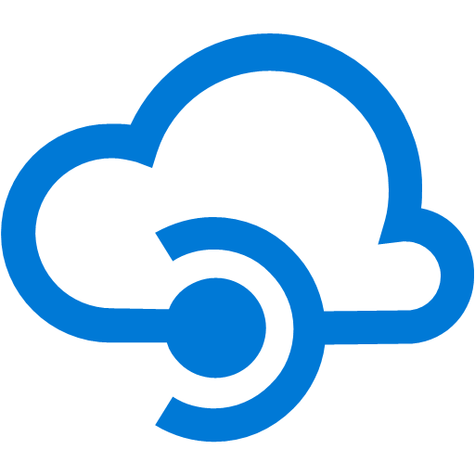




























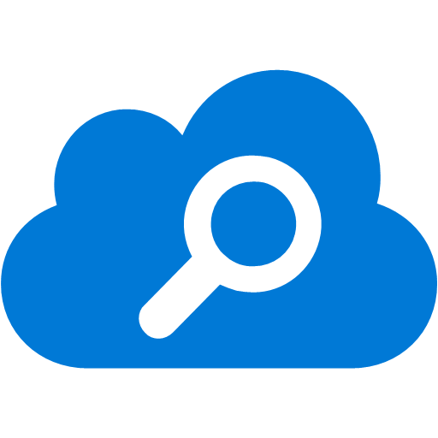


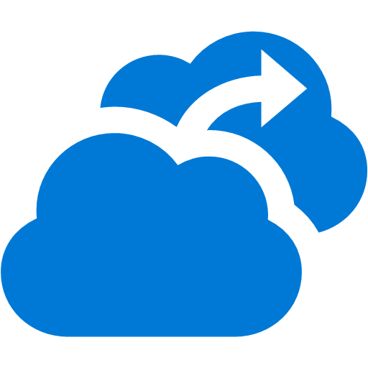












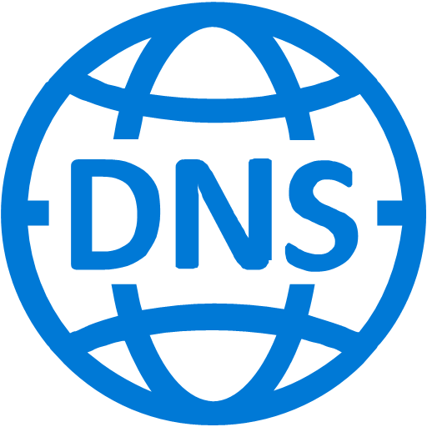




Azure Platform Services
Security & Management
Compute
Web and Mobile
Developer Services
Hybrid
Operations
Cloud
Services
Service
Fabric
Web Apps
API
Apps
API
Management
Visual Studio
Azure SDK
Portal
Azure AD
Connect Health
Active
Directory
Batch
Remote App
Mobile
Apps
Logic
Apps
Notification
Hubs
Team Project
Application
Insights
AD Privileged
Identity
Management
Multi-Factor
Authentication
Integration
Analytics & IoT
Data
Automation
Backup
Storage
Queues
Biztalk
Services
Key Vault
HDInsight
Machine
Learning
SQL
Database
SQL Data
Warehouse
Operational
Insights
VM Image Gallery
& VM Depot
Hybrid
Connections
Service
Bus
Data
Factory
Event
Hubs
Redis
Cache
Search
Import/Export
Azure Security
Center
Media & CDN
Stream
Analytics
Site
Recovery
Mobile
Engagement
DocumentDB
Tables
Store /
Marketplace
Media
Services
Content Delivery
Network (CDN)
StorSimple
Azure Infrastructure Services
Compute
Storage
Networking
Virtual Machines
Containers
BLOB Storage
Azure Files
Premium Storage
Virtual Network
Load Balancer
DNS
Express
Route
Traffic Manager
VPN Gateway
Application Gateway
Azure Datacenter Infrastructure (24 Regions, 19 Online)
Notes:
Slide script:
Microsoft Azure is a growing collection of integrated cloud services—analytics, computing, database, mobile, networking, storage, and web—for moving faster, achieving more, and saving money. Any developer or IT professional can be productive with Azure.
In this presentation we’re focusing on the security & management aspects of the platform. Please note that this green area is just a small part of the full security picture – in a few moments you’ll see just how broad that is.

Slide 5
SECURING THE PLATFORM
EMPOWERING YOU
Notes:
Slide script:
To help our customers make sense of the different security features and options with Azure, we’ve organized this presentation into two primary buckets: securing the platform, and empowering you.
Many of our security controls do both of these things, so you’ll hear about different functions of some of the same features in each section.
Let’s start with securing the platform:

Slide 6
Securing the Platform
Security Development Lifecycle (SDL)
Infrastructure security controls
Operational security controls
Compliance
Security Embedded in Planning, Design, Development, & Deployment
Datacenter Security
Secure Multi-tenancy
Network Protection
DDoS Defense
Data Segregation
Data Protection
Prevent & Assume Breach Strategy
Incident Response
Access Policy & Controls
Threat Detection
Forensics
Strategy
Certifications
Notes:
Slide script:
Strong security protects customer content from unauthorized access by using state-of-the-art industry technology, best practices and certifications. Secure cloud solutions are the result of comprehensive planning, intelligent design, and efficient operations. Microsoft makes security a priority at every step, from code development to incident response.

Slide 7
Security Development Lifecycle
Education
Process
Accountability
Administer and track security training
Guide product teams to meet SDL requirements
Establish release criteria & sign-off as part of FSR
Incident
Response (MSRC)
Training
Requirements
Design
Implementation
Verification
Release
Response
Ongoing Process Improvements
Security Development Lifecycle
Infrastructure security controls
Operational security controls
Compliance
Notes:
Topline point: hard and fast rule – every software team goes through this, every release – it’s also embedded in our internal governance.
Slide script:
The Microsoft Security Development Lifecycle (SDL) is a set of processes and tools designed to minimize the number and severity of vulnerabilities in software products. It encompasses education of development personnel, secure development processes, and accountability of individuals and product teams, all for the building of more consistently secure software.
Azure uses the SDL to systematically address security threats throughout the development process: through threat modeling during the design process; following development best practices and code security standards during coding; and requiring the use of various tools for testing and verification before deployment. These proactive checks during development make software less vulnerable to potential threats after release, and the SDL provides a structured and consistent methodology through which to apply them. These methodologies, which are supported by an executive commitment to security, have helped Microsoft develop more secure software.

Slide 8

Datacenter Security
Barriers
Fencing
Perimeter
Seismic bracing
Security operations center
24X7 security staff
Days of backup power
Building
Cameras
Alarms
Two-factor access control: Biometric readers & card readers
Computer room
Security Development Lifecycle
Infrastructure security controls
Operational security controls
Compliance
Notes:
Slide script:
Microsoft datacenters employ controls at the perimeter, building, and computer room with increasing security at each level, utilizing a combination of technology and traditional physical measures.
Security starts at the perimeter with camera monitoring, security officers, physical barriers and fencing.
At the building, seismic bracing and extensive environmental protections protect the physical structure and integrated alarms, cameras, and access controls (including two-factor authentication via biometrics and smart cards) govern access. The systems are monitored 24x7 from the operations center.
Similar access controls are used at the computer room, which also has redundant power.

Slide 9
Secure Multi-tenancy
Customer
Admin
Microsoft Azure
Isolates customer environments using the Fabric Controller
Runs a configuration-hardened version of Windows Server as the Host OS
Uses Hyper-V – a battle tested and enterprise proven hypervisor
Portal
Smart API
Customer 1
Customer 2
Guest VM
Guest VM
Guest VM
Fabric
Controller
Hypervisor
Host OS
End
Users
Azure Storage
SQL Database
Security Development Lifecycle
Infrastructure security controls
Operational security controls
Compliance
Notes:
Slide Script:
Azure is architected for secure multi-tenancy. It’s designed to abstract much of the infrastructure that typically underlies applications (servers, operating systems, Web and database software, and so on) so that developers can focus on building applications—and not on managing resources. The goal is to provide a secure, consistent, scalable set of resources for each customer that they can manage through a subscription, created through www.windowsazure.com and associated with a Microsoft account or organizational account. A set of Azure technologies isolate each customer’s environment from others:
The The Fabric Controller (FC) functions as the kernel of the Azure platform, managing resources as needed. The FC provisions, stores, delivers, monitors and commands the VMs and physical servers that make up the Azure customer environment and infrastructure.
The Host OS is a configuration-hardened version of Windows Server.
The Hypervisor is Hyper-V from Windows Server 2012, which has been battle-tested and proven in enterprise environments worldwide
The Guest VM OS can be either Windows Server or chosen and supplied by the customer. (Customer-controlled VMs are called guest VMs, and the guests that run on them are the guest OS.)

Slide 10
Network Protection
INTERNET
Provides logical isolation while enabling customer control
Restricts access from the Internet, permits traffic only to endpoints, and provides load balancing and NAT at the Cloud Access Layer
Private IP addresses are isolated from other customers
Client
Microsoft Azure
Cloud Access
Layer
RDP Endpoint
(password access)
Customer 1
Customer 2
Subnet 1
Subnet 2
Subnet 3
Deployment X
Deployment Y
Corp 1
VPN
VLAN-to-VLAN
DNS Server
Isolated Virtual Networks
Security Development Lifecycle
Infrastructure security controls
Operational security controls
Compliance
Notes:
Slide script:
With Azure, you can literally create a virtual “datacenter” in the Cloud. You can do this by leveraging a feature called Virtual Network (VNET) which allows you to create a logically isolated section of Azure and treat it like your own network. You can customize the network configuration for a VNET - create subnets, assign private IP addresses and bring your own DNS server if you wish. Within a virtual network for example, you can create a public-facing subnet for your webservers that has access to the Internet, and place your backend systems such as databases or application servers in a private-facing subnet with no Internet access. You can enable VNETs to connect to other VNETS. And, you can securely connect your Azure Virtual Network to on-premises infrastructure (we’ll look at options for securely connecting next).
AZURE:
Provides logical isolation while enabling customer control via Virtual Networks
Azure does not enable internet access by default
Azure enables access from the internet and remote devices through Private IP addresses isolated from other customers
Azure networking provides the infrastructure necessary to securely connect VMs to one another and to connect on-premises data centers with Azure VMs. Azure blocks unauthorized traffic to and within Microsoft data centers using a variety of technologies such as firewalls, NATs, partitioned Local Area Networks and physical separation of back-end servers from public-facing interfaces.
Network isolation. Network isolation prevents unwanted tenant-to-tenant communications, and access controls block unauthorized users from the network. Virtual machines do not receive inbound traffic from the Internet unless customers configure them specifically to do so.
Virtual Networks. A customer can choose to assign multiple deployments within a subscription to a virtual network and allow those deployments to communicate with each other through private IP addresses. Each virtual network is isolated from other virtual networks.
Encrypting communications. Built-in cryptographic technology enables customers to encrypt communications within and between deployments, between Microsoft Azure regions, and from Microsoft Azure to on-premises data centers. Encryption can be configured to protect administrator access to virtual machines through remote desktop sessions and remote Windows PowerShell. Access to the Microsoft Azure Management Portal is encrypted by default using HTTPS. Customers can use an optional Express Route private fiber link into Microsoft Azure data centers to keep their traffic off the Internet.
Firewalls:
Azure blocks unauthorized traffic to and within Microsoft datacenters, using a variety of technologies such as firewalls, partitioned local area networks (LANs), and the physical separation of back-end servers from public-facing interfaces.
Azure Virtual Networks use a combination of logical isolation, firewalls, access controls, authentication, and encryption to protect customer data in-transit.
The mechanisms for administrators to manage network security on their Azure private networks are in the Azure Cloud Access Layer, which is comparable to the edge of a corporate network that faces the Internet. The Cloud Access Layer includes a firewall, load-balancer, and network address translation (NAT) functionality managed by the customer administrator.
Restricts access from the Internet, permits traffic only to endpoints, and provides load balancing and NAT at the Cloud Access Layer
Isolates traffic and provides intrusion defense through a distributed firewall
CUSTOMER:
Creates Virtual Networks with Subnets and Private IP addresses. You retain control over the network topology and configuration, and manage it in the same way you would your on-premises infrastructure.
Enables communications between their Virtual Networks
Can brings their own DNS
Can domain join their Virtual Machines
Virtual Network makes it easier to build cloud applications hosted in a hybrid environment, maintaining secure connections with on-premises infrastructure without the creation of custom codes. For example, a web application hosted in Azure can securely access an on-premise SQL Server database server or authenticate users against an on-premise Active Directory service.
Security Groups
A Network Security Group consists of a set of access control rules that describe traffic filters.
Provides control over network traffic flowing in and out of customer services in Azure
Provides segmentation within a Virtual Network for multi-tier applications
Enables access control rule changes to be applied across Virtual Networks to thousands of machines in seconds

Slide 11
DDoS Defense System
Internet
Azure’s DDoS defense system is designed not only to withstand attacks from the outside, but also from within.
Azure monitors and detects internally initiated DDoS attacks and removes offending VMs from the network
MSFT Routing Layer
Routing Updates
Profile DB
Flow Data
Detection Pipeline
Attack Traffic
Scrubbed Traffic
Scrubbing Array
SLB
Application
Security Development Lifecycle
Infrastructure security controls
Operational security controls
Compliance
Notes:
Slide script:
There are more distributed denial-of-services (DDoS) attacks than ever before, and they vary widely; they can be highly targeted or generic, long in duration or short. And they mutate; there’s a new breed of DDoS attacks that use Web servers as payload carrying bots, which makes them even more deadly because of exponential performance increases. And then there are application attacks, which are often targeted towards at financial systems, which can bring a company to its knees.
Azure has a defense system against DDoS attacks on Azure platform services. It uses standard detection and mitigation techniques such as SYN cookies, rate limiting, and connection limits. Azure’s DDoS defense system is designed to withstand attacks generated from outside and inside the platform.
Azure’s DDoS defense system is designed not only to withstand attacks from the outside, but also from within.
Azure monitors and detects internally initiated DDoS attacks and removes offending VMs from the network.
Azure’s DDoS protection also benefits applications. However, it is still possible for applications to be targeted individually. As a result, customers should actively monitor their Windows Azure applications.
Supported DDOS Attack Profiles:
TCP SYN
UDP/ICMP/TCP Flood
Detection Process
Traffic to a given /32 VIP Inbound or Outbound is tracked, recorded, and analyzed in real time to determine attack behaviour
Mitigation Process
Traffic is re-routed to scrubbers via dynamic routing updates
Traffic is SYN auth. and rate limited

Slide 12
Data Segregation
Customer
Admin
Microsoft Azure
Stored data accessible only through claims-based IDM & access control with private key
Storage blocks are hashed by the hypervisor to separate accounts
SQL Azure isolates separate account databases
VM switch at the host level blocks inter-tenant communication
Portal
Smart API
Customer 1
Customer 2
Guest VM
Guest VM
Guest VM
Fabric
Controller
Hypervisor
Host OS
End
Users
Azure Storage
Access
Control
SQL Database
Security Development Lifecycle
Infrastructure security controls
Operational security controls
Compliance
Notes:
Slide script:
Microsoft Azure uses logical isolation to segregate each customer’s data from that of others. This provides the scale and economic benefits of multitenant services while rigorously preventing customers from accessing one another’s data.
Storage isolation:
Data accessible only through claims-based IDM & access control with a Storage Access Key (SAK). Shared Access Signature (SAS) tokens can be generated using storage access keys to provide more granular, restricted access. Storage access keys can be reset via the Microsoft Azure Portal or SMAPI.
Storage blocks are hashed by the hypervisor to separate accounts
SQL isolation:
SQL Azure isolates separate account databases
Network isolation:
VM switch at the host level blocks inter-tenant communication

Slide 13
Data Protection
Data segregation
At-rest data protection
Logical isolation segregates each customer’s data from that of others.
Customers can implement a range of encryption options for virtual machines and storage.
In-transit data protection
Encryption
Industry-standard protocols encrypt data in transit to/from outside components, as well as data in transit internally by default.
Data encryption in storage or in transit can be deployed by the customer to align with best practices for ensuring confidentiality and integrity of data.
Data redundancy
Data destruction
Customers have multiple options for replicating data, including number of copies and number and location of replication datacenters.
When customers delete data or leave Azure, Microsoft follows procedures to render the previous customer’s data inaccessible.
Security Development Lifecycle
Infrastructure security controls
Operational security controls
Compliance
Notes:
Slide script:
Both technological safeguards, such as encrypted communications, and operation processes help keep customer data secure. Customers have the flexibility to implement additional encryption and manage their own keys.
Data isolation. Azure is a multi-tenant service, meaning that multiple customers’ deployments and virtual machines are stored on the same physical hardware. Azure uses logical isolation to segregate each customer’s data from that of others. This provides the scale and economic benefits of multitenant services while rigorously preventing customers from accessing one another’s data.
Data at rest. Customers are responsible for ensuring that data stored in Azure is encrypted in accordance with their standards. Azure offers a wide range of encryption capabilities, giving customers the flexibility to choose the solution that best meets their needs.
Data in transit. For data in transit, customers can enable encryption for traffic between their own VMs and end users. Azure protects data in transit to or from outside components, as well as data in transit internally, such as between two virtual networks. Azure uses industry standard transport protocols such as TLS between user devices and Microsoft datacenters, and within datacenters themselves.
Encryption management. Encryption of data in storage and in transit can be used by Azure customers align with best practices for ensuring confidentiality and integrity of data. It is straightforward for customers to configure their Azure cloud services to use SSL to protect communications from the Internet and even between their Azure hosted VMs.
Data redundancy. Microsoft ensures data is protected in the event of a cyberattack or physical damage to a datacenter. Customers may opt for in-country storage for compliance or latency considerations or out-of-country storage for security or disaster recovery purposes. Data may be replicated within a selected geographic area for redundancy, but will not be transmitted outside it.
When you create your storage account, you must select one of the following replication options:
•Locally redundant storage (LRS). Locally redundant storage maintains three copies of your data. LRS is replicated three times within a single facility in a single region. LRS protects your data from normal hardware failures, but not from the failure of a single facility.
•Zone-redundant storage (ZRS). Zone-redundant storage maintains three copies of your data. ZRS is replicated three times across two to three facilities, either within a single region or across two regions, providing higher durability than LRS. ZRS ensures that your data is durable within a single region.
•Geo-redundant storage (GRS). Geo-redundant storage is enabled for your storage account by default when you create it. GRS maintains six copies of your data. With GRS, your data is replicated three times within the primary region, and is also replicated three times in a secondary region hundreds of miles away from the primary region, providing the highest level of durability. In the event of a failure at the primary region, Azure Storage will failover to the secondary region. GRS ensures that your data is durable in two separate regions.
Data destruction. When customers delete data or leave Azure, Microsoft follows strict standards for overwriting storage resources before reuse, as well physical destruction of decommissioned hardware. Microsoft executes a complete deletion of data on customer request and on contract termination.

Slide 14
Prevent & Assume Breach
Prevent Breach is a defensive strategy aimed at predicting and preventing a security breach
The Assume Breach strategy, unique to Microsoft, is a key operational practice that hardens cloud services
Leverages Microsoft’s vast threat intelligence
Includes state of the art security monitoring and response
Prevent breach
Secure Development Lifecycle
Physical security controls
Operational security controls
Assume breach
Bug Bounty Program
War game exercises
Live site penetration testing
Security Development Lifecycle
Infrastructure security controls
Operational security controls
Compliance
Notes:
Slide script:
Microsoft takes a two prong approach to threat defense, which they refer to as Prevent Breach and Assume Breach.
Prevent Breach is a defensive strategy aimed at predicting and preventing a security breach:
continuous improvements to built-in security features including;
port scanning and remediation,
perimeter vulnerability scanning,
OS Patching to latest updated security software,
network level DDOS (Distributed Denial of Service) detection & prevention,
multi-factor authentication for service access.
The Assume Breach strategy, unique to Microsoft, and is is a key operational practice that it uses to harden its cloud services.
Red team simulates real-world attacks at the network, platform, and application layers.
Blue team detects, protect against, and recovers.
Identifying and ejecting attackers, limiting what access an attacker would have if various layers were breached – we do this though techniques like segregation of duties, and how quickly we can restore the environment in the event of a breach.
By constantly challenging the security capabilities of the service, Microsoft can stay ahead of emerging threats and be prepared to act quickly to threats.

Slide 15



Incident Response
DevOps Engaged
Security Team
Engaged
Event Detected
Incident Assessment
Event
Start
Security Event Confirmed
Customer Notification
Customer Process
Step 1
Determine Affected Customers
Determine Customer Impact
Azure Customer
Notification
In-depth 9-step incident response process
Focus on containment & recovery
Makes contractual commitments regarding customer notification + provides forensics
Security Development Lifecycle
Infrastructure security controls
Operational security controls
Compliance
Notes:
Slide script:
The security controls and risk management processes Microsoft has in place to secure the cloud infrastructure reduce the risk of security incidents, but in the event an incident occurs, the Security Incident Management (SIM) team within the Microsoft Online Security Services & Compliance (OSSC) team is ready 24 hours a day, every day to respond. SIM’s mission is to quickly and accurately assess and mitigate computer security incidents involving Microsoft's Online Services, while managing the necessary internal and customer communications.
When events are detected, a 9-step process is kicked off that focuses first on containment and recovery. Customers notification is a key part of this process. Customers notification is a key part of this process. Microsoft Azure provides coordination of forensic analysis, evaluation of logs, and VHD images in the event of platform-level incident. Azure also works with customers to provide log data to help them respond to threats.
AZURE:
Leverages a 9-step incident response process
Focuses on containment & recovery
Analyzes logs and VHD images in the event of platform-level incident and provides forensics information to customers when needed
Makes contractual commitments regarding customer notification

Slide 16
Access Policy & Controls
Just-in-Time &
Role-Based Access
Pre-screened Admin requests access
Microsoft Azure
BLOBS
TABLES
QUEUES
DRIVES
Leadership grants
temporary privilege
Microsoft Corporate Network
No standing access to the platform and no access to customer Virtual Machines
Grants least privilege required to complete task; access requests are audited and logged
Multi-factor authentication required for all administration
Security Development Lifecycle
Infrastructure security controls
Operational security controls
Compliance
Notes:
Slide script:
Access to customer data by Microsoft operations and support personnel is denied by default. When granted (requires leadership approval), access is carefully managed and logged. The access control requirements are established by Microsoft Azure Security Policy:
No access to customer data by default
No user / administrator accounts on customer VMs
Logging and monitoring when local accounts are created on VMs
Microsoft Azure support personnel are assigned unique Corporate AD accounts by Microsoft as part of the standard new employee onboarding process. Microsoft Azure Access Control SOP was reviewed by BSI in the course of Microsoft Azure ISO 27001 certification. Microsoft Azure relies on Microsoft Corporate Active Directory, managed by MSIT, to control access to key information systems. Multi-factor authentication is required, and access is only granted from secure consoles.
All access attempts are monitored and can be displayed via a basic set of reports.

Slide 17
Threat Detection
INTERNET
End Users
THREAT DETECTION: DOS/IDS Layer
Microsoft Azure
Provides big data analysis of logs for intrusion detection & prevention for the platform
Employs denial of service attack prevention measures for the platform
Regularly performs penetration testing
Cloud Access & Firewall Layer
Customer Environment
Virtual Network
DOS/IDS Layer
Application Tier
Corp 1
VPN
DOS/IDS Layer
Logic Tier
DOS/IDS Layer
Database Tier
Security Development Lifecycle
Infrastructure security controls
Operational security controls
Compliance
Notes:
Slide script:
Intrusion detection and DDoS attack prevention are employed to help mitigate threats from outside the system as well as attacks staged by other customers.
AZURE:
Provides big data analysis of logs for intrusion detection & prevention for the platform. If anomalous activity is detected, teams are notified and threats mitigated through the incident response process discussed earlier.
Employs denial of service attack prevention measures for the platform. Azure uses standard detection and mitigation techniques such as SYN cookies, rate limiting, and connection limits to protect against DDoS attacks.
Regularly performs penetration testing
CUSTOMER:
Can add extra layers of protection by deploying additional controls, including web application firewalls from partners like Barracuda Network’s Web Application Firewall
Conducts penetration testing of their applications

Slide 18
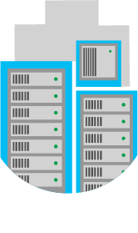
Forensics
!
!
!
Provides coordination, analysis of logs and VHD images in the event of platform-level incident
Provides forensic data to customers when needed
Security Development Lifecycle
Infrastructure security controls
Operational security controls
Compliance
Notes:
Slide script:
In the event of a security incident, Microsoft Azure forensic tools can help identify and mitigate threats. Customers can reduce the need to invest in these capabilities on their own and benefit from economies of scale in Microsoft datacenter infrastructure. Microsoft Azure provides coordination of forensic analysis, evaluation of logs, and VHD images in the event of platform-level incident. Azure also works with customers to provide log data to help them respond to threats. It is the customer’s responsibility to conduct further forensic analysis and coordinate with law enforcement as necessary.
AZURE:
Provides coordination, analysis of logs and VHD images in the event of platform-level incident
CUSTOMER:
Contacts Microsoft for forensic data when needed
Uses standard security response and forensics processes

Slide 19
Security compliance strategy
Business Objectives
Industry Standards & Regulations
Security goals set in context of business and industry requirements
Security analytics & best practices deployed to detect and respond to threats
Benchmarked to a high bar of certifications and accreditations to ensure compliance
Continual monitoring, test and audit
Ongoing update of certifications for new services
Test and audit
Security analytics
Security Compliance
Framework
Security benchmark analysis
Risk management best practices
Certificates and Attestations
Security Development Lifecycle
Infrastructure security controls
Operational security controls
Compliance
Notes:
Slide title: Security compliance strategy
Slide objective: Explain how Azure is designed with a compliance strategy that helps customers address business objectives and industry standards & regulations.
Slide script:
Azure is designed with a compliance strategy that helps customers address business objectives and industry standards & regulations. Our security compliance framework includes test and audit phases, security analytics, risk management best practices, and security benchmark analysis to achieve certificates and attestations:
Security goals are set in context of business and industry requirements
Security analytics & best practices are deployed to detect and respond to threats
Benchmarked to a high bar of certifications and accreditations to ensure compliance
Continual monitoring, test and audit
Ongoing updates of certifications & attestations

Slide 20
Certifications & programs
Program | Description
ISO/IEC 27001 | The ISO/IEC 27001:2005 certificate validates that Azure has implemented the internationally recognized information security controls defined in this standard.
SOC 1 SSAE 16/ISAE 3402 | Azure has also been audited against the Service Organization Control (SOC) reporting framework for SOC 1 Type 2 (formerly SAS 70), attesting to the design and operating effectiveness of its controls.
SOC 2 | Azure has been audited for SOC 2 Type 2, which includes a further examination of Azure controls related to security, availability, and confidentiality
FedRAMP/FISMA | Azure has received Provisional Authorization to Operate from the Federal Risk and Authorization Management Program (FedRAMP) Joint Authorization Board (JAB), having undergone the assessments necessary to verify that it meets FedRAMP security standards.
PCI DSS Level 1 | Azure has been validated for PCI-DSS Level 1 compliance by an independent Qualified Security Assessor (QSA).
UK G-Cloud IL2 | In the United Kingdom, Azure has been awarded Impact Level 2 (IL2) accreditation, further enhancing Microsoft and its partner offerings on the current G-Cloud procurement Framework and CloudStore.
HIPAA BAA | To help customers comply with HIPAA and HITECH Act security and privacy provisions, Microsoft offers a HIPAA Business Associate Agreement (BAA) to healthcare entities with access to Protected Health Information (PHI).
Spain ENS | Microsoft was the first hyperscale CSP to receive this ENS certification—for Microsoft Azure and Microsoft Office 365
Security Development Lifecycle
Infrastructure security controls
Operational security controls
Compliance
Notes:
Slide title: Certificates & programs
Slide objective: This includes a description of many of the audits, certifications and programs Microsoft Azure has achieved.
Slide script:
ISO/IEC 27001
Received ISO/IEC 27001:2005 certificate from BSI on 11/29/2011 for Microsoft Azure Core Services; recertified in Dec 2012
Broad international information security standard. Acts as security baseline.
The ISO/IEC 27001:2005 certificate validates that Microsoft has implemented the internationally recognized information security controls defined in this standard.
ISO 27001/27002 (True certification/International Std.)
PCI DSS Level 1
Information security standard designed to prevent fraud through increased controls around credit card data
SOC 1 / SSAE 16
Successor to SAS 70 attestations.
An accounting standard that is relied upon as the authoritative guidance for reporting on service organizations.
It illustrates Microsoft’s willingness to open up internal security programs to outside scrutiny.
The end result is auditor’s report on the effectiveness and suitability of selected controls to achieve desired control objectives during the period under review. Detailed SSAE 16 report can then be shared with customers under NDA.
Audit report (SOC 1 Type 2) available for Microsoft Azure core services in June 2012.
SOC 2
Azure has been audited for SOC 2 Type 2, which includes a further examination of Azure controls related to security, availability, and confidentiality
FedRamp/FISMA
Federal Information Security Management Act of 2002 (FISMA) is a U.S. federal law that defines a comprehensive framework to protect government information, operations, and assets against natural and man-made threats
Required by law for U.S. federal agencies, and looked on favorably by other government agencies
Azure has received Provisional Authorization to Operate from the Federal Risk and Authorization Management Program (FedRAMP) Joint Authorization Board (JAB), having undergone the assessments necessary to verify that it meets FedRAMP security standards.
PCI DSS
Azure has been validated for PCI-DSS Level 1 compliance by an independent Qualified Security Assessor (QSA).
Customers are responsible for achieving PCI DSS certification for the applications they run in Azure.
A guide is available that details what DSS requirements are fulfilled by Azure and which requirements the customer is responsible for.
UK G-Cloud IL2
‘Protect' level of security for data processing, storage and transmission by UK public sector organization including local and regional government
Health Insurance Portability and Accountability Act (HIPAA)
Specifies privacy, security, and disaster recovery guidelines for electronic storage of health records.
No platform can be HIPAA compliant; what is needed, though, is Business Associate Agreement (BAA) that enables third parties to build HIPAA compliant applications on Microsoft Azure. We need to sign a BAA with the Covered Entity if Protected Health Information (PHI) they are responsible for is to be stored, processed or otherwise accessed by Azure
Substantial overlap with ISO controls, i.e., HIPAA program will benefit substantially from ISO work
HIPAA BAA available for Microsoft Azure core services in June 2012
Others:
EU-US Safe Harbor Framework
Microsoft (including, for this purpose, all of our U.S. subsidiaries) is Safe Harbor certified with the U.S. Department of Commerce.
This allows for legal transfer of data to Microsoft for processing from within European Union and countries with aligned data protection laws.
Microsoft acts as the data processor and, to the extent of the Service’s capabilities, decisions regarding data usage are made by the data controller.
EU Data Protection Directive
Law that sets a baseline for handling personal date in the EU
US standards meet EU requirements through US Safe Harbor
Microsoft self-attests compliance under the US Safe Harbor framework, which lets us transfer EU PII outside EU, and even allows the “onward-transfer” from the US to another country
However, EU regulators and customers increasingly consider the Safe Harbor to be inadequate and are asking for EU Model Contractual Clauses. We currently offer to sign EU MC for WA core services.

Slide 21
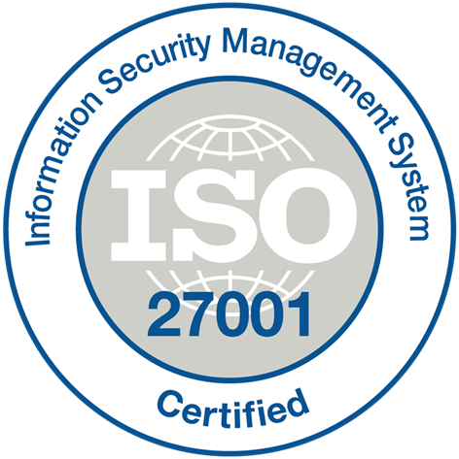
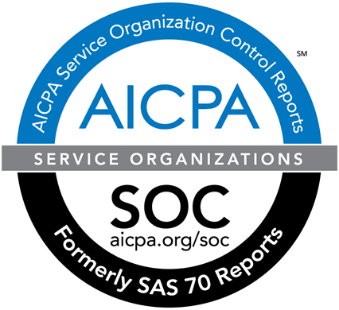
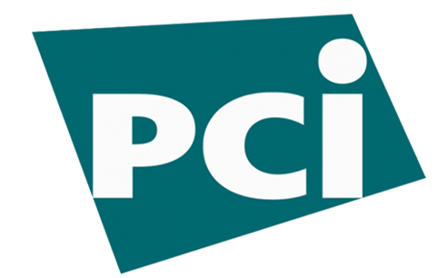
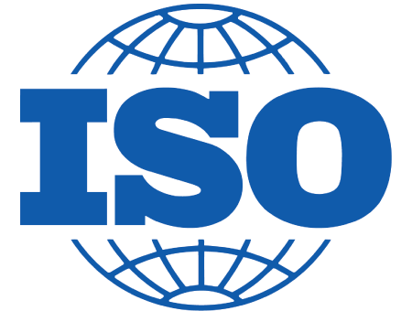


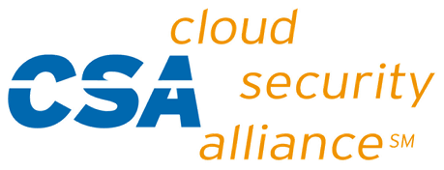
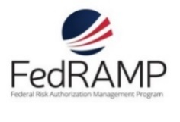




















Azure Compliance
The largest compliance portfolio in the industry
ISO 27001
SOC 1 Type 2
SOC 2 Type 2
PCI DSS Level 1
Cloud Controls Matrix
ISO 27018
Content Delivery and Security Association
Shared
Assessments
FedRAMP JAB P-ATO
HIPAA / HITECH
FIPS 140-2
21 CFR
Part 11
FERPA
DISA Level 2
CJIS
IRS 1075
ITAR-ready
Section 508 VPAT
European Union
Model Clauses
EU Safe Harbor
United Kingdom
G-Cloud
China Multi
Layer Protection Scheme
China
GB 18030
China
CCCPPF
Singapore
MTCS Level 3
Australian Signals
Directorate
New
Zealand
GCIO
Japan
Financial Services
ENISA
IAF
Security Development Lifecycle
Infrastructure security controls
Operational security controls
Compliance

Slide 22
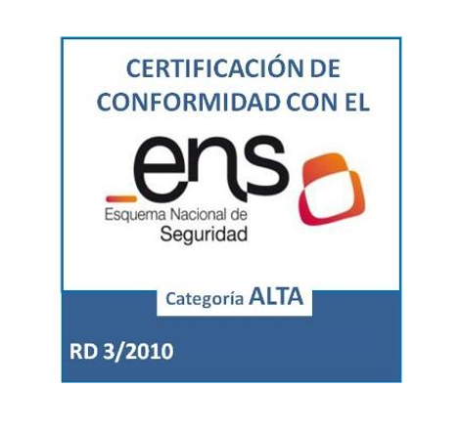
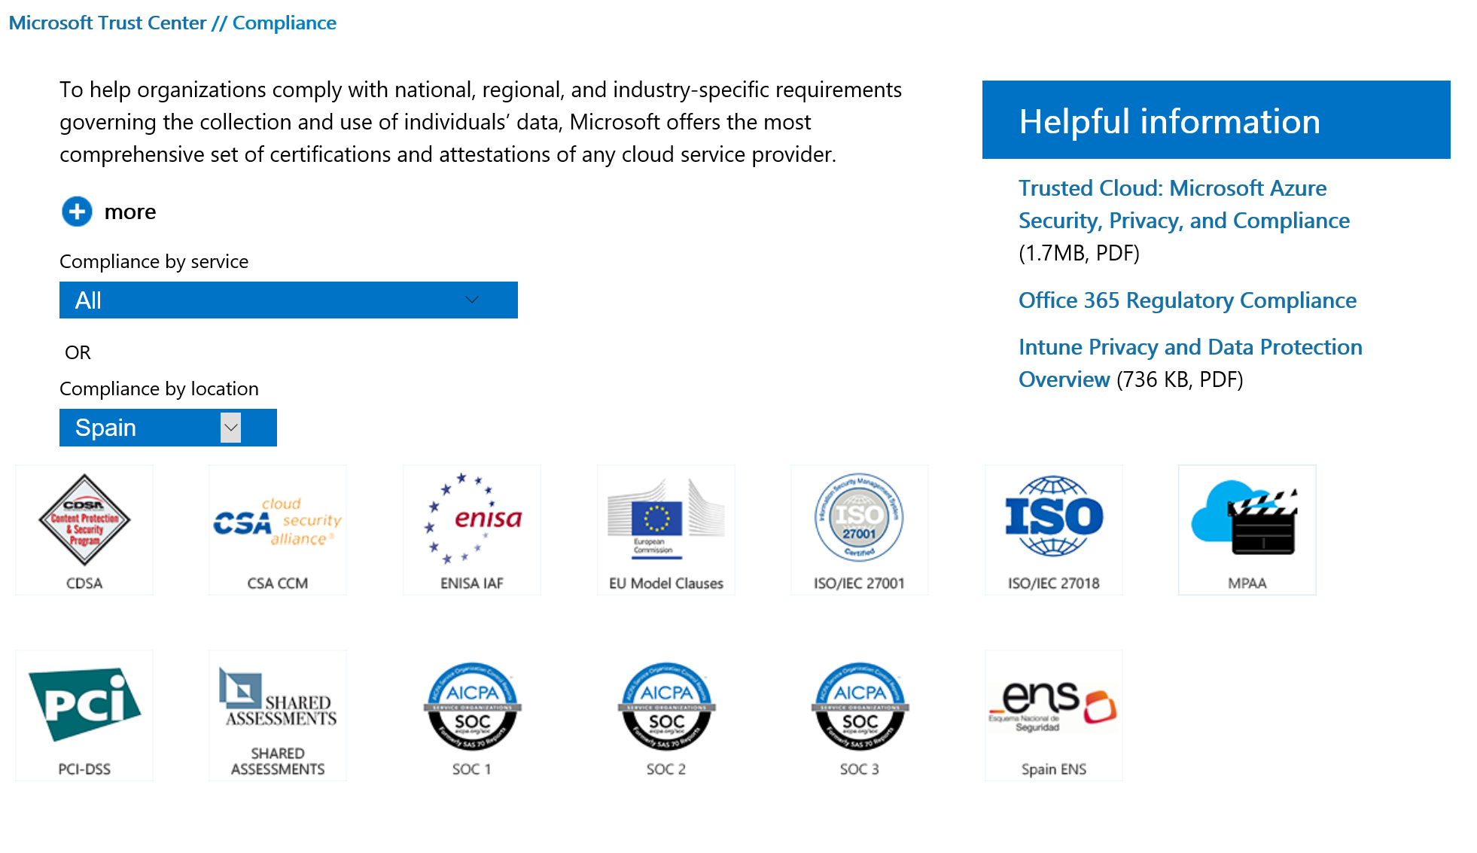
Azure Compliance
ENS Certificate
Security Development Lifecycle
Infrastructure security controls
Operational security controls
Compliance

Slide 23

Empowering You
Security Management
Encryption
Secure Networking
Partner Solutions
Identity & Access
Data Control
Host Protection
Operations Management Suite
Azure Security Center
Key Vault
Options for Encryption at Rest
Options for Encryption in Transit
SQL Encryption
Disk Encryption
Network Security Groups
VPN
ExpressRoute
Azure Marketplace
Notes:
At the end of the day, all of that is for this – empowering you to deliver secure experiences and services to your customers.
Delivering experiences securely requires a partnership between our platform services and how you enact security policies and controls. This section will provide a 200-level tour of your options with Azure, to help you think about the decisions you’ll need to make for different deployments.

Slide 24
Identity & Access: Overview
Microsoft Employee Access
Access monitoring and logging
Just-in-time and role-based access; grants least privilege required for task; monitors and logs access requests.
Security reports monitor access patterns that help identify potential threats.
Enterprise Cloud
Azure AD: Single Sign-on
Multi-Factor Authentication
Azure Active Directory (AAD) offers enterprise identity and access management in the cloud.
Developers can integrate their app with Azure AD for single sign-on functionality
Strong authentication adds an extra layer of security for user logins.
Security Management
Encryption
Secure Networking
Partner Solutions
Notes:
Slide script:
Azure enables customers to control access to their environments, data and applications. Microsoft offers comprehensive and federated identity and access management solutions for customers to use across Azure and other services such as Office 365, helping them simplify the management of multiple environments and control user access across applications.

Slide 25
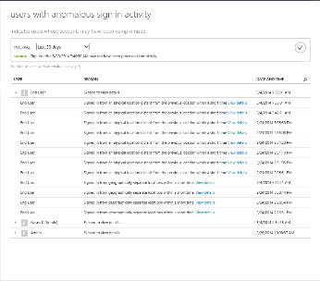
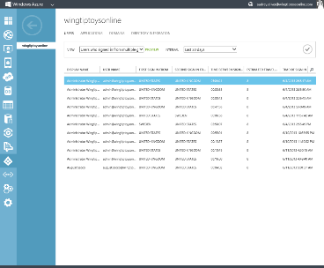

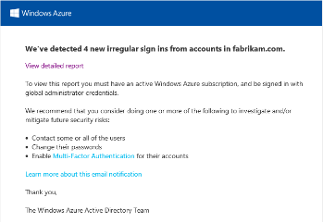
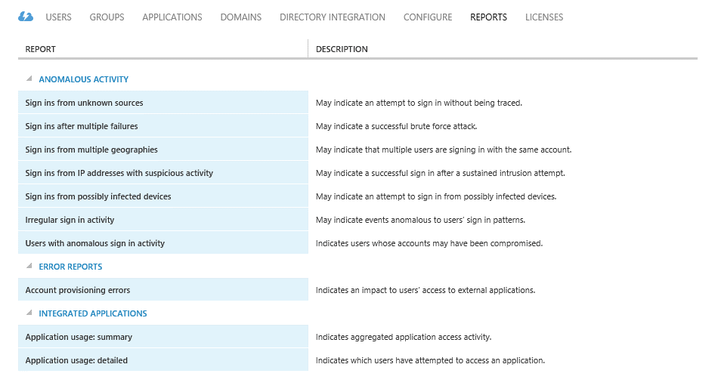
Access monitoring and logging
Security reporting that tracks inconsistent access patterns, analytics and alerts.
Discover, restrict and monitor privileged identities and their access to resources
Enforce on-demand, just in time administrative access when needed
Reporting API lets you export data to other systems
Security Management
Encryption
Secure Networking
Partner Solutions
Notes:
Note to Ryan – need talk track for this slide

Slide 26
Identity & Access: Azure AD
Centrally manage users and access to Azure, O365, and hundreds of pre-integrated cloud applications
Build Azure AD into your web and mobile applications
Can extend on-premises directories to Azure AD through synchronization
Azure
Active Directory
Cloud Apps
End Users
Active Directory
Security Management
Encryption
Secure Networking
Partner Solutions
Notes:
Slide script:
Azure Active Directory is a comprehensive identity and access management solution for the cloud that provides a robust set of capabilities to manage users and groups and help secure access to applications including Microsoft online services like Office 365 and a world of non-Microsoft SaaS applications. It combines core directory services, advanced identity governance and application access management. Azure Active Directory also offers a rich standards-based platform that enables developers to deliver access control to their applications, based on centralized policy and rules.
AZURE:
Uses Azure AD to govern access to the management portal with granular access controls for users and groups on subscription or resource groups
Provides enterprise cloud identity and access management
Enables single sign-on across cloud applications
Offers Multi-Factor Authentication for enhanced security
CUSTOMER:
Centrally manages users and access to Azure, O365, and hundreds of pre-integrated cloud applications
Builds Azure AD into their web and mobile applications
Can extend on-premises directories to Azure AD through synchronization

Slide 27
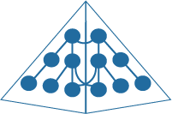



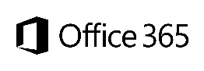

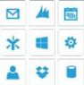
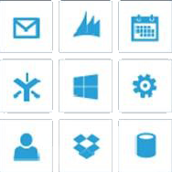
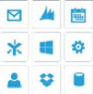
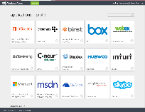
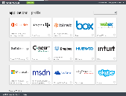
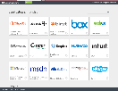
Identity & Access: Single Sign-On
Review reports and mitigate potential threats
Can enable Multi-Factor Authentication
Active Directory
Active Directory
Other Directories
Microsoft apps
Custom LOB apps
ISV/CSV apps
Non-MS cloud-based apps
PCs and devices
Security Management
Encryption
Secure Networking
Partner Solutions
Notes:
Slide Script:
Organizations need a hub that can sync their on-premises Active Directory (and other non-MS directories), seamlessly connect with many cloud applications, can integrate with various protocols and can scale around the globe to authenticate users everywhere from any device in a way that integrates simply with their existing identities. With more than 95% of fortune 1000 organizations using Windows Server Active Directory on premise, they would prefer not to reinvent the wheel or recreate all of their identities. The good news is that they don’t have to.
That’s exactly what Microsoft Azure Active Directory provides. And it does that in a secure and comprehensive manner.
AZURE:
Uses encrypted password hashes for synchronization, which means that we do not store user passwords for synchronized scenarios.
Offers security reporting that tracks inconsistent traffic patterns, including:
Sign ins from unknown sources
Multiple failed sign ins
Sign ins from multiple geographies in short timeframes
Sign ins from suspicious IP addresses and suspicious devices
CUSTOMER:
Reviews reports and mitigates potential threats
Can enable Multi-Factor Authentication

Slide 28


Identity & Access: Multi Factor Authentication
Protect sensitive data and applications both on-premises and in the cloud with Multi Factor Authentication
Can use Active Directory (on-premises) with Azure Active Directory (in cloud) to enable single sign-on, a single directory, and centralized identity management
Multi Factor Authentication can be implemented with Phone Factor or with AD on-premises
Microsoft Azure
Active Directory
Active Directory
Security Management
Encryption
Secure Networking
Partner Solutions
Notes:
Slide script:
Azure Active Directory (Azure AD) provides an easy way for your business to manage identity and access, both in the cloud and on-premises. Your users can use one work or school account for single sign-on to any cloud and on-premises web application, using their favorite device, including iOS, Mac OS X, Android, and Windows devices. Your organization can protect sensitive data and applications both on-premises and in the cloud with integrated multi-factor authentication ensuring secure local and remote access. Or extend your on-premises directories so that information workers can use a single organizational account to securely and consistently access their corporate resources.
You can use Two Factor Authentication or DevOPs access to your production services. For Two Factor Authentication, you can implement it with Phone Factor or with AD on-premises.

Slide 29
Data Control: Overview
When a customer utilizes Azure, they own their data
Control over data location
Control over access to data
Control over data deletion
Encryption key management
Customers choose data location and replication options.
Strong authentication, carefully logged “just in time” support access, and regular audits (see Data Control section).
When customers delete data or leave Azure, Microsoft follows procedures to render the previous customer’s data inaccessible.
Customers have the flexibility to generate and manage their own encryption keys (see Encryption section).
Security Management
Encryption
Secure Networking
Partner Solutions
Notes:
Slide script:
Customers own their data. This belief is fundamental to the Microsoft approach. When a customer utilizes Azure, they retain exclusive ownership of their data.
Control over data location. When customers entrust their data to Microsoft, they are not giving up control. For many customers, knowing and controlling the location of their data can be an important element of data privacy, compliance, and governance. Microsoft gives customers the freedom to choose the geographic areas where their data is stored, whether that includes in-country storage for compliance or latency considerations or out-of-country storage for security or disaster recovery purposes. Data may be replicated within a selected geographic area for redundancy, but will not be transmitted outside it.
Control over access to data. Strong authentication, including the use of multi-factor authentication, helps limit access to customer data to authorized personnel only. Sample audits are performed by both Microsoft and third parties to attest that access is only for appropriate business purposes. When access is granted, it is carefully controlled and logged, and revoked as soon as it is no longer needed.
Control over data destruction. When customers delete data or leave Azure, Microsoft follows procedures to render the previous customer’s data inaccessible storage resources before reuse
Encryption key management. To ensure control over encrypted data, customers have the option to generate and manage their own encryption keys, and determine who is authorized to use them. They also have the option to revoke Microsoft’s copy of their encryption key, although this may limit Microsoft’s ability troubleshoot or repair problems and security threats.
Detail on Data destruction:
When a customer deletes a blob or table entity, we immediately delete it from our index used to locate and access the data on the primary location, and then that delete is done asynchronously at the geo-replicated copy of the data. At the primary location a customer can immediately try to access the blob or entity and they won’t find it in their index, since we provide strong consistency for the delete. Customers can only read from disk space they have written to. If a customer leaves Azure, we preserve that data for a specified period of time, generally 90 days, before deleting the data.
Microsoft uses NIST compliant disk disposal processes. For hard drives that can’t be wiped we use a destruction process that destroys it (i.e. shredding) and renders the recovery of information impossible (e.g., disintegrate, shred, pulverize, or incinerate). The appropriate means of disposal is determined by the asset type. Records of the destruction are retained. All Microsoft Azure services utilize approved media storage and disposal management services. Paper documents are destroyed by approved means at the pre-determined end-of-life cycle.

Slide 30

Choice of Data Location & Replication
AZURE:
Provides 3 copies of data in each datacenter
Offers geo-replication in a datacenter 400+ miles away
CUSTOMER:
Chooses where data resides
Configures data replication options
Security Management
Encryption
Secure Networking
Partner Solutions
Notes:
Slide title: Choice of data location & replication
Slide objective: Explain how Microsoft Azure makes multiple copies of your data in each location – so even if you have your data in one location, you still have 3 different copies.
Slide script:
Microsoft Azure customers can specify the geographic areas where their customer data is stored. Data may be replicated within a geographic area for redundancy, but will not be transmitted outside it. Microsoft Azure replicates data both locally and to different physical locations.
To guard against hardware failures and improve availability, every blob is replicated across three computers in a Microsoft Azure datacenter.
To ensure more robust backup, Windows offers geo-replicated storage
Microsoft may transfer Customer Data within a geo (e.g., within Europe) for data redundancy or other purposes. For example, Azure replicates Blob and Table data between two regions within the same geo for enhanced data durability in case of a major data center disaster. Microsoft will not transfer Customer Data outside the geo(s) customer specifies (for example, from Europe to U.S. or from U.S. to Asia) except where necessary for Microsoft to provide customer support, troubleshoot the service, or comply with legal requirements; or where customer configures the account to enable such transfer of Customer Data.

Slide 31

Host Protection: Monitoring, Firewalls, AV
Configure monitoring, export events for analysis
Configure Microsoft Antimalware or an AV/AM solution from a partner
Apply corporate firewall using site-to-site VPN, configures endpoints
Define access controls between tiers and provide additional protection via the OS firewall
Monitor and respond to alerts
Enable Monitoring Agent
Microsoft Azure
Customer VMs
Portal
SMAPI
Guest VM
Guest VM
Cloud Services
Customer
Admin
Events
Azure storage
HDInsight
Extract event information to SIEM or other reporting system
!
Alerting & reporting
Security Management
Encryption
Secure Networking
Partner Solutions
Notes:
Let’s take a moment to walk through customer options around monitoring and alerts, firewalls, and Antimalware/Antivirus. We’ll look at what Azure provides and what you manage on your side.
Monitoring
AZURE:
Performs monitoring & alerting of security events for the platform
Enables security data collection via Monitoring Agent or Windows Event Forwarding
CUSTOMER:
Configures monitoring
Exports events to SQL Database, HDInsight or a SIEM for analysis
Monitors alerts & reports
Responds to incidents
Firewalls:
AZURE:
Restricts access from the Internet, permits traffic only to endpoints, and provides load balancing and NAT at the Cloud Access Layer
Isolates traffic and provides intrusion defense through a distributed firewall
CUSTOMER:
Applies corporate firewall using site-to-site VPN
Configures endpoints
Defines access controls between tiers and provides additional protection via the OS firewall
Antimalware/Antivirus
AZURE:
Performs monitoring & alerting of security events for the platform. Azure also scans all software components (including OS) deployed to Azure for malware as part of our internal build and deployment.
Enables real time protection, on-demand scanning, and monitoring via Microsoft Antimalware for Cloud Services and Virtual Machines
CUSTOMER:
Configures Microsoft Antimalware or an AV/AM solution from a partner
Extracts events to SIEM
Monitors alerts & reports
Responds to incidents
For added assurance, VMs can be routinely reimaged to clean out intrusions that may have gone undetected.

Slide 32
Update Management
Move to Securing the Platform
Monitor 100,000+ vulnerability reports
Sourced from customers & worldwide network of security researchers
Reviews and tests all changes
MONTHLY MSRC PATCH REVIEW
AZURE:
Apply patch management as a service
Rigorously reviews & tests all changes
CUSTOMER:
Applies similar patch management strategies for their Virtual Machines
AUDIT VALIDATION
PATCHING ROLLOUT
Reconciliation report
Resolution summary
Prioritize critical updates
Monthly OS releases with patches
SCANNING
Scanning & reporting of all Azure VMs
Track & remediate any findings
Security Management
Encryption
Secure Networking
Partner Solutions
Notes:
Key point – patch management as a service – this gets done for you!
Slide script:
Security patches help protect systems from known vulnerabilities. Integrated deployment systems manage the distribution and installation of security updates for the Azure service. Customers can apply similar update management processes for virtual machines (VMs) deployed on Azure.
AZURE:
Microsoft Azure works with MSRC to identify when patch releases are required, and applies patches immediately or during a scheduled release to the Microsoft Azure environment based on the severity. Microsoft Azure is notified by the Microsoft Security Response Center (MSRC) and Microsoft Online Security Services & Compliance (OSSC) teams upon identification of updates applicable to Azure environment. This includes the notification of the latest patches released. Microsoft Azure works with MSRC and evaluates patch releases to determine applicability and impact to the Microsoft Azure environment and customers. The applicable security patches are released through the periodic OS release cycle in accordance with change and release management procedures. Emergency out-of-band security patches (e.g., Software Security Incident Response Process (SSIRP) patches) are expedited for more immediate release.
The patches are automatically applied to the customers’ Guest VMs unless the customer has configured the VM for manual upgrades. In this case, the customer is responsible for patching.
Microsoft Azure follows a change process to modify the underlying OS within the platform. All changes are reviewed and tested, at a minimum, for their quality, performance, impact on other systems, recovery objectives and security features before they are moved into production using the Microsoft Azure Release process. Microsoft Azure has established test windows for reviewing and testing of new features, changes to existing features and patches.
CUSTOMERS:
Customers apply patches to their Virtual Machines using Systems Center or whatever other processes they use on-premises.

Slide 33
Operations Management Suite
Collect security-related events and perform forensic, audit, and breach analysis
Identification of missing system updates across data centers or in a public cloud
Comprehensive updates assessment across datacenters and public clouds
Comprehensive view into your organization’s IT security posture
Detection of breaches and threats with malware assessment
Collection and analysis of security related events
Perform forensic, audit and breach analysis
Security Management
Encryption
Secure Networking
Partner Solutions
Notes:
Slide script:
Identify missing system updates and malware status. Collect security-related events and perform forensic, audit, and breach analysis. Enable cloud-based patch management for all your environments.
Help secure your workloads, servers, and users

Slide 34
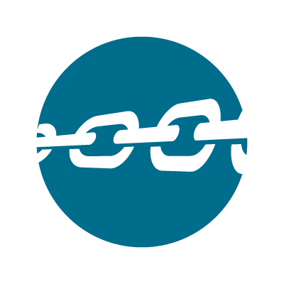








New! Azure Security Center
Gain visibility and control
Integrated security, monitoring, policy management
Built in threat detections and alerts
Works with broad ecosystem of security solutions
Set Policy & Monitor
Understand
Current State
Deploy Integrated Solutions
Continue learning
Visibility & Control
Deploy & Detect
Find threats that might go unnoticed
Respond & recover faster
Security Management
Encryption
Secure Networking
Partner Solutions
Notes:
Slide script:
Azure Security Center helps you prevent, detect and respond to threats with increased visibility and control over the security of all your Azure resources. It provides a central view of security across your subscriptions, and enables you to set policies and monitor security configurations. Policy-driven recommendations guide resource owners through the process of implementing security controls and enable rapid deployment of integrated Microsoft and partner security solutions. Security-related events from across your Azure deployments are automatically collected and analyzed using Microsoft global threat intelligence and expertise to identify actual threats and reduce false alarms. The resulting real-time alerts offer insights into the attack campaign and suggest ways to remediate and recover quickly.

Slide 35


Microsoft Azure Key Vault
Key Vault offers an easy, cost-effective way to safeguard keys and other secrets used by cloud apps and services using HSMs.
You manage your keys and secrets
Applications get high performance access to your keys and secrets… on your terms
Microsoft Azure
IaaS
PaaS
SaaS
Key Vault
Import keys
HSM
Security Management
Encryption
Secure Networking
Partner Solutions
Notes:
Azure Key Vault offers an easy, cost-effective way to safeguard keys and other secrets used by cloud apps and services. With Key Vault, customers can streamline key management and maintain control of keys used to access and encrypt their data.
Key management lifecycle
Security Operations - Supplies keys
Creates a Key Vault in Azure
Adds keys / secrets to the Vault
Grants permission to specific application(s) to perform specific operations using keys e.g. decrypt, unwrap
Enables usage logs
Developer/IT Pro - Deploys application
Tells application the URI of the key / secret
Application programmatically uses key / secret (and may abuse)
Auditor - Monitors access to keys
Reviews usage logs to confirm proper key use and compliance with data security standards

Slide 36




Options for Encryption at Rest
Virtual Machines:
Data drives – full disk encryption through BitLocker
Boot drives – partner solutions
SQL Server – Transparent Data Encryption
Files & folders - EFS in Windows Server
Storage:
Bitlocker encryption of drives for import/export of data
StorSimple with AES-256 encryption
Applications:
Client Side encryption through .NET Crypto API
RMS SDK for file encryption by your applications
Virtual Machines
SQL TDE
Bitlocker
Partners
EFS
Storage
Bitlocker
StorSimple
Applications
.NET Crypto
RMS SDK
Security Management
Encryption
Secure Networking
Partner Solutions
Notes:
Slide script:
Customers are responsible for ensuring that data stored in Azure is encrypted in accordance with their standards. Azure offers a wide range of encryption capabilities up to AES-256, giving customers the flexibility to choose the solution that best meets their needs.
Virtual Machines:
Data drives – full disk encryption through BitLocker
Boot drives – partner solutions
SQL Server – Transparent Data Encryption
EFS in Windows Server (?)
Storage:
Client Side encryption through .NET Crypto API
Bitlocker encryption of drives for import/export of data
StorSimple:
Encrypts data using AES-256
Applications:
RMS SDK for data encryption by your applications

Slide 37
Options for Encryption in Transit
Azure
Data Center
Can choose HTTPS for REST API (recommended) for Storage
Configure HTTPS endpoints for application running in Azure
Encrypt traffic between Web client and server by implementing TLS on IIS
Azure
Portal
Azure
Data Center
Encryption key management
Security Management
Encryption
Secure Networking
Partner Solutions
Notes:
Slide script:
Azure uses encryption to help secure communications between and within datacenters and from customers. Customers can configure communications using SSL and TLS.
AZURE:
Encrypts most communication between Azure datacenters with a commitment to encrypt all traffic by the end of 2014
Encrypts transactions through Azure Portal using HTTPS
Only accepts encrypted disks for import/export of data
Supports FIPS 140-2 ciphers
CUSTOMER:
Can choose HTTPS for REST API (recommended) for Storage
Configure HTTPS endpoints for application running in Azure
Encrypt traffic between Web client and server by implementing TLS on IIS

Slide 38


Disk Encryption
Encrypted Disks
Storage
Encryption Extension
VM’s are secured at rest using industry standard encryption technology to address organizational security and compliance requirements.
VM’s boot under customer controlled keys and policies, and they can audit their usage in Key Vault.
Virtual Machine
Upload Key
Customer Key Vault
HOST
Azure Active Directory
Security Management
Encryption
Secure Networking
Partner Solutions
Notes:
Slide script:
VM’s are secured at rest using industry standard encryption technology to address organizational security and compliance requirements.
VM’s boot under customer controlled keys and policies, and they can audit their usage in Key Vault.
Important capability for majority of customers to meet security/compliance and win trust
Threats Addressed
Loss of Disks
Data breach
Loss of storage account keys
Process for Encryption
Customer opts into enabling disk encryption
Customer provides identity and other encryption configuration to Azure Portal/API to provision encryption key material* in their key vault
Azure service management updates service model with encryption and key vault configuration and Azure platform pushes the encryption extension on the VM
Encryption extension initiates encryption on the VM
VM is encrypted
*Key Material: BitLocker Encryption Keys [Windows], Passphrase [Linux]

Slide 39
SQL Encryption: Overview
Encryption Type | Type | Customer Value
Encryption-In-Transit | TLS from Client to Server TLS = Transport Layer Security | Protects data between client and server against snooping & man-in-the-middle attacks. SQL DB is phasing out SSL 3.0 and TLS 1.0 in favor of TLS 1.2.
Encryption-At-Rest | TDE for SQL DB TDE = Transparent Data Encryption | Protects data on disk. Key management done by Azure. Makes it easier to obtain compliance.
Encryption-End-To-End | Client-side column encryption for SQL DB (library available for download) | Data protected end-to-end but application is aware of encrypted columns. Used in the absence of data masking and TDE for compliance related scenarios.
End-To-End
In-Transit
At-Rest
Customer Data
Database Files, Backups, Tx Log, TempDB
Security Management
Encryption
Secure Networking
Partner Solutions
Notes:
Slide script:
Azure SQL includes a number of additional security measures for data – this slide provides an overview of SQL encryption in transit, at rest, and end-to-end.
Key takeaway: Encrypted sensitive data and its corresponding keys are never seen in plain text in SQL Server
The customer will need to verify in the Azure portal that the database is encrypted via PowerShell/T-SQL

Slide 40
Secure Networking: Options
Azure networking provides the infrastructure necessary to securely connect VMs to one another and to connect on-premises datacenters with Azure VMs
Virtual Networks
Customers can connect one or more cloud services using private IP addresses.
Network Security Groups
Customers can control network traffic flowing in and out of customer services in Azure.
VPN
Customers can securely connect to a virtual network from anywhere.
ExpressRoute
Customers can create private connections between Azure datacenters and infrastructure that’s on your premises or in a colocation environment.
Security Management
Encryption
Secure Networking
Partner Solutions
Notes:
Slide script:
Azure networking provides the infrastructure necessary to securely connect VMs to one another and to connect on-premises datacenters with Azure VMs. Azure blocks unauthorized traffic to and within Microsoft datacenters using a variety of technologies such as firewalls, NATs, partitioned Local Area Networks and physical separation of back-end servers from public-facing interfaces.
Network isolation. In Azure, a customer subscription can include multiple deployments, and each deployment can contain multiple tenants, or virtual machines (VMs). Network isolation prevents unwanted tenant-to-tenant communications, and access controls block unauthorized users from the network. Virtual machines do not receive inbound traffic from the Internet unless customers configure them specifically to do so. The overarching principle within Azure is to allow only connections and communications that are necessary for cloud services to operate, blocking all other ports and connections by default.
Virtual Networks. A customer can choose to assign multiple deployments within a subscription to a virtual network and allow those deployments to communicate with each other through private IP addresses. Each virtual network is isolated from other virtual networks.
VPN and ExpressRoute. Microsoft enables connection from customer sites and remote workers to Azure Virtual Networks using Site-to-Site and Point-to-Site VPNs. For even better performance, customers can use an optional Express Route, a private fiber link into Azure datacenters that keeps their traffic off the Internet.

Slide 41
Virtual Networks & Security Groups
INTERNET
Create Virtual Networks with Subnets and Private IP addresses
Configure access control rules, which can be applied across Virtual Networks to thousands of machines in seconds
Can bring your own DNS and can domain join your VMs
Client
Microsoft Azure
Cloud Access
Layer
RDP Endpoint
(password access)
Customer 1
Customer 2
Subnet 1
Subnet 2
Subnet 3
Deployment X
Deployment Y
Corp 1
VPN
VLAN-to-VLAN
DNS Server
Isolated Virtual Networks
Security Management
Encryption
Secure Networking
Partner Solutions
Notes:
Slide script:
With Azure, you can literally create a virtual “datacenter” in the Cloud. You can do this by leveraging a feature called Virtual Network (VNET) which allows you to create a logically isolated section of Azure and treat it like your own network. You can customize the network configuration for a VNET - create subnets, assign private IP addresses and bring your own DNS server if you wish. Within a virtual network for example, you can create a public-facing subnet for your webservers that has access to the Internet, and place your backend systems such as databases or application servers in a private-facing subnet with no Internet access. You can enable VNETs to connect to other VNETS. And, you can securely connect your Azure Virtual Network to on-premises infrastructure (we’ll look at options for securely connecting next).
AZURE:
Provides logical isolation while enabling customer control via Virtual Networks
Azure does not enable internet access by default
Azure enables access from the internet and remote devices through Private IP addresses isolated from other customers
Azure networking provides the infrastructure necessary to securely connect VMs to one another and to connect on-premises data centers with Azure VMs. Azure blocks unauthorized traffic to and within Microsoft data centers using a variety of technologies such as firewalls, NATs, partitioned Local Area Networks and physical separation of back-end servers from public-facing interfaces.
Network isolation. Network isolation prevents unwanted tenant-to-tenant communications, and access controls block unauthorized users from the network. Virtual machines do not receive inbound traffic from the Internet unless customers configure them specifically to do so.
Virtual Networks. A customer can choose to assign multiple deployments within a subscription to a virtual network and allow those deployments to communicate with each other through private IP addresses. Each virtual network is isolated from other virtual networks.
Encrypting communications. Built-in cryptographic technology enables customers to encrypt communications within and between deployments, between Microsoft Azure regions, and from Microsoft Azure to on-premises data centers. Encryption can be configured to protect administrator access to virtual machines through remote desktop sessions and remote Windows PowerShell. Access to the Microsoft Azure Management Portal is encrypted by default using HTTPS. Customers can use an optional Express Route private fiber link into Microsoft Azure data centers to keep their traffic off the Internet.
Firewalls:
Azure blocks unauthorized traffic to and within Microsoft datacenters, using a variety of technologies such as firewalls, partitioned local area networks (LANs), and the physical separation of back-end servers from public-facing interfaces.
Azure Virtual Networks use a combination of logical isolation, firewalls, access controls, authentication, and encryption to protect customer data in-transit.
The mechanisms for administrators to manage network security on their Azure private networks are in the Azure Cloud Access Layer, which is comparable to the edge of a corporate network that faces the Internet. The Cloud Access Layer includes a firewall, load-balancer, and network address translation (NAT) functionality managed by the customer administrator.
Restricts access from the Internet, permits traffic only to endpoints, and provides load balancing and NAT at the Cloud Access Layer
Isolates traffic and provides intrusion defense through a distributed firewall
CUSTOMER:
Creates Virtual Networks with Subnets and Private IP addresses. You retain control over the network topology and configuration, and manage it in the same way you would your on-premises infrastructure.
Enables communications between their Virtual Networks
Can brings their own DNS
Can domain join their Virtual Machines
Virtual Network makes it easier to build cloud applications hosted in a hybrid environment, maintaining secure connections with on-premises infrastructure without the creation of custom codes. For example, a web application hosted in Azure can securely access an on-premise SQL Server database server or authenticate users against an on-premise Active Directory service.
Security Groups
Slide script:
A Network Security Group consists of a set of access control rules that describe traffic filters.
AZURE:
Provides control over network traffic flowing in and out of customer services in Azure
Provides segmentation within a Virtual Network for multi-tier applications
Enables access control rule changes to be applied across Virtual Networks to thousands of machines in seconds
CUSTOMER:
Configures access control rules, (source and destination IPs and ports)

Slide 42
VPN Connections
Microsoft Azure
Customer 1
Deployment X
Customer Site
Connect your sites and remote workers to Azure Virtual Networks using Site-to-Site or Point-to-Site VPNs
You own and manage certificates, policies, and user access
Site-to-Site VPN
VPN
Point-to-Site VPN
Computers Behind Firewall
Isolated Virtual Network
Remote Workers
Security Management
Encryption
Secure Networking
Partner Solutions
Notes:
Slide script:
Let’s say you have individual PCs behind the firewall that you want to connect directly to Azure—or that you have remote workers. You can connect securely to the virtual network In Azure from anywhere using the VPN client in Windows. Because it works across firewalls and proxies, it doesn’t matter if users are behind your firewall, behind someone else’s firewall, or are remote.
AZURE:
Enables connection from customer sites and remote workers to Azure Virtual Networks using Site-to-Site and Point-to-Site VPNs
CUSTOMERS:
Configures the VPN client in Windows
Manages certificates, policies, and user access

Slide 43
Azure ExpressRoute
Microsoft Azure
Customer 1
Can establish connections to Azure at an ExpressRoute location (Exchange Provider facility)
Can directly connect to Azure from your existing WAN network (such as a MPLS VPN) provided by a network service provider
You own and manage certificates, policies, and user access
ExpressRoute
Peer
Deployment X
Site 1
WAN
Site 2
Isolated Virtual Network
Security Management
Encryption
Secure Networking
Partner Solutions
Notes:
Slide script:
Azure ExpressRoute enables you to create private connections between Azure datacenters and infrastructure that’s on your premises or in a colocation environment. ExpressRoute connections do not go over the public Internet, and offer more reliability, faster speeds, lower latencies and higher security than typical connections over the Internet.
AZURE:
Offers private fiber connections via ExpressRoute
Enables access to Compute, Storage, and other Azure services
CUSTOMERS:
Can establish connections to Azure at an ExpressRoute location (Exchange Provider facility)
Can directly connect to Azure from your existing WAN network (such as a MPLS VPN) provided by a network service provider
Manages certificates, policies, and user access

Slide 44

Trusted by Leading Companies
Security Management
Encryption
Secure Networking
Partner Solutions
Notes:
Slide script:
We’re proud to have earned the trust of the organizations here – and we look forward to providing these same trusted cloud services to you.

Slide 45
Security Partners
In addition to the robust security capabilities built into Azure, the Azure Marketplace offers a rich array of additional security products built by our partners for Azure.
Antimalware
Networking security
Encryption
Monitoring and alerts
Messaging Security
Application Security
Authentication
Virtual machines
Kaspersky
Trend Micro
Active Directory integrations
Symantec
McAfee
aiScaler
Barracuda
Check Point
Riverbed
Cohesive Networks
F5
Cisco
CloudFlare
Imperva
Fortinet
CloudLink
Townsend Security
Alert Logic
Derdack
Nagios
Imperva
Kaspersky
Barracuda
Trend Micro
Waratek
Login People
Security Management
Encryption
Secure Networking
Partner Solutions
Notes:
Slide script:
The Azure Marketplace offers a rich array of security products built by Azure partners.
Anti-malware
Azure partners offer leading antimalware solutions for virtual machines, as well as through Active Directory integrations.
Networking security
Azure networking provides the infrastructure necessary to securely connect VMs to one another and to connect on-site datacenters with Azure VMs. Azure partners offer a variety of services to block unauthorized traffic, utilize firewalls, provide network routing, offer denial of service tools, and process application traffic.
Encryption
Technological safeguards, such as encrypted communications and operation processes, help keep customer data secure. Azure partners offer tools that control when and where your VMs boot and help you manage encryption keys.
Monitoring and alerts
To help you manage the large amount of information generated by devices within the Azure environment, Azure offers centralized monitoring and analysis systems that provide continuous visibility and timely alerts to the teams who manage the service. Azure partners offers services that manage your infrastructure and threats and that automate and centralize alert notification processes.
Messaging security
Azure partners help protect inbound and outbound mail, stop malware, lock spam, prevent phishing, and stop advanced persistent threats.
Application security
Azure partner Waratek offers Waratek Locker that provides Runtime Application Self Protection (RASP) to help you secure your applications and environment against business logic and network layer threats such as SQL injection and zero-day attacks.
Authentication
Azure partner Login People offers Digital DNA Server, a multifactor authentication server based on recognizing Digital DNA devices. It allows users to authenticate themselves not only with “what they know” (a password), but with “what they own” (their computer, smartphone, or USB key)..

Slide 46
Enabling Hybrid Identity

Slide 47
Extending On-Premises AD to Azure
When working with virtual machines in an Infrastructure as a Service (IaaS) environments, they most often need to be joined to an Active Directory domain. There exist two options two domain join IaaS VMs
Deploy a domain controller in Azure
Extend on-premises domain services to Azure through a VPN connection
The following are consideration topics around extending Active Directory to Azure VMs in a safe and reliable manner:
Networking
Storage
Security
Deployment
Administration
AD Design

Slide 48
Extending On-Premises AD - Networking
When considering extending Active Directory to Azure, there are two primary areas of networking that need focus:
Connecting on-premises Domain Controllers to Azure VMs
If a customer wants to keep Domain Controllers on-premises, they will need either an ExpressRoute connection or a Site-to-Site VPN connection into Azure.
Networking the Domain Controllers in Azure with the virtual networks in IaaS
Virtual machines in Azure get IP addresses assigned dynamically from the vNet that they reside in.
In general, it is safe to allow Azure to assign a dynamic IP address to a DC. If, however, you want a domain controller to have a specific IP address, you can configure Azure to provide a static IP to the DC.
Every time a VM in Azure needs to access a Domain Controller, it will traverse this connection over the WAN.

Slide 49
Domain Controllers in Azure IaaS
Domain controllers are highly sensitive roles
This topic area creates complexity for Azure implementations and is one of the first steps to enabling traditional IaaS workloads
Most concerns focus on trust of the service
Many alternative solutions do not support seamless lift and shift migration to Azure
Domain Controllers in Azure
Most customers will strongly consider placing domain controllers in Azure because they will want the applications
However, Domain controllers are highly sensitive roles.
Read-Only Domain Controllers
Do not use Read-Only Domain Controllers as a security measure in Azure.
A primary reason that the use of RODCs is discouraged in Azure is that application compatibility is unpredictable.
Understand how Azure is secured to avoid risk doubts in placing a DC in Azure.
In addition, RODCs, by design, redirect a client’s LDAP write request to a RWDC
Windows Server Core
Unless a customer is already using Domain Controllers running on Windows Server Core on-premises, MS would not recommend asking customers to use Server Core for Azure-based Domain Controllers.

Slide 50
Extending On-Premises AD - Security
Protecting VHDs
Create a separate Storage Account for Domain Controller VHDs, and make sure that no one has the API keys.
Limiting Endpoint Exposure
Remove the Remote Desktop endpoint from Domain Controller virtual machines in Azure.
Remove the WinRM endpoint from Domain Controller virtual machines in Azure.
Limit access to the Azure Management Portal to administrators that really need it, to prevent unauthorized people from getting access to the API keys for the Storage Account that the Domain Controller VHDs are stored in.
Encrypt Domain Controller VHDs in Azure using a 3rd party partner solution, such as CloudLink SecureVM.

Slide 51
Recommendations
Network
Provide Domain Controller with static vNet IP
Disable Internet Endpoints
Storage
Place Database and SYSVOL on data disks
Security
Consider using a separate subscription to host the Domain Controllers
Create a separate Storage Account for Domain Controller VHDs, and make sure that no one has the API keys.
Use writable Domain Controllers
Protect Domain Controllers with Backups
Consider protecting Domain Controllers VHD with Encryption (first or third party)
Use Windows Server Full edition instead of Windows Server Core
Sizing
Start out with A5 virtual machines. Use A6 in case more memory is needed for caching the database
Management
Do not shutdown the Domain Controllers from the portal but from the OS
AD Design
Place two Domain Controllers in all Azure regions and in within an availability set
Create a unique AD Site for each Azure region and associate all of the vNets in that region with that AD Site
Make all Domain Controllers in Azure Global Catalogs
Domain Controllers should be DNS Servers as well. If using DNS Server from third-party, consider deploying additional DNS Servers/Appliances in Azure
Additional information:
Guidelines for Deploying Windows Server Active Directory on Azure Virtual Machines,
https://msdn.microsoft.com/library/azure/jj156090.aspx

Slide 53
Privacy by design
Privacy by Design
Restricted data access
& use
Contractual commitments
Privacy controls built into Azure design and operations
Customer data is only used to provide the service and is never used for advertising
Data Processing Agreements, EU Model Clauses, HIPAA BAA
10101010101010101010101010101010
1010101010101010101010101010101010101010101010101010
1010101010101010101010101010
Notes:
Slide title: Privacy by design.
Slide objectives: Provide an overview of privacy by design with Microsoft Azure.
Slide script:
Privacy by Design. With Microsoft, customers can expect Privacy by Design, a policy that guides how Microsoft builds products and services, how services are operated, and how internal teams are organized.
Restricted data access and use. Access to customer data by Microsoft personnel is restricted. Customer Data is only accessed when necessary to support the customer’s use of Microsoft Azure. This may include troubleshooting aimed at preventing, detecting or repairing problems affecting the operation of Microsoft Azure and the improvement of features that involve the detection of, and protection against, emerging and evolving threats to the user (such as malware or spam). When granted, access is carefully controlled and logged. Strong authentication, including the use of multi-factor authentication, helps limit access to authorized personnel only. Access is revoked as soon as it is no longer needed.
No use for advertising. Microsoft Azure does not share Customer Data with its advertiser-supported services, nor is customer data mined for advertising.
Contractual commitments. Microsoft is unique among major cloud service providers in providing cloud-service-specific privacy statements and making strong contractual commitments to safeguard customer data and protect privacy. Microsoft makes the standard contractual clauses created by the European Union (known as the “EU Model Clauses”) available to enterprise customers to provide additional contractual guarantees concerning transfers of personal data. Recently, Brad Smith announced that Microsoft’s cloud contracts have been validated by European Union data protection authorities as meeting the rigorous privacy standards that regulate companies operating in E.U. member states.

Slide 54
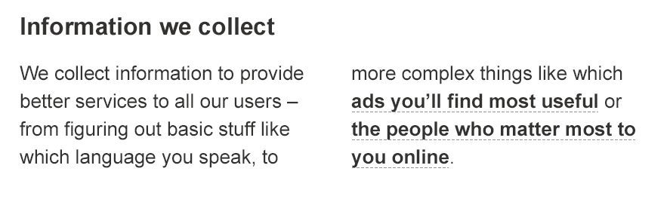
Restricted use
Read the fine print of other cloud service provider’s privacy statements
Azure does not share data with its advertiser-supported services
Azure does not mine Customer Data for advertising
Notes:
Slide title: Restricted use
Slide objective: Explain how Azure does not share data with its advertiser-supported services and does not mine customer data for advertising.
Slide script:
Microsoft will use the Customer Data you store in Azure only for purposes consistent with providing you the services. We will not use your Customer Data or derive information from it for advertising purposes, and we will not sell your Customer Data.
Azure does not share data with its advertiser-supported services. Azure does not mine Customer Data for advertising.

Slide 55
Contractual commitments
Microsoft meets high bar for protecting privacy of EU customer data
Microsoft offers customers EU Model Clauses for transfer of personal data across international borders
Microsoft’s approach was approved by the Article 29 committee of EU data protection authorities – the first company to obtain this
EU Data Privacy Approval
Broad contractual scope
Microsoft makes strong contractual commitments to safeguard customer data covered by HIPAA BAA, Data Processing Agreement, & E.U. Model Clauses
Enterprise cloud-service specific privacy protections benefit every industry & region
Notes:
Slide title: Contractual commitments
Slide objective: Explain how Microsoft is unique among major cloud service providers in making strong contractual commitments to safeguard customer data and protect privacy.
Slide script:
We recognize how critical data privacy is to enabling our customers to move to the cloud, and Microsoft has been a pioneer in offering privacy protections for its enterprise cloud services. We were the first to offer contractual commitments for customers subject to the E.U. Data Protection Directive and U.S. HIPAA laws, which call for safeguarding personal data, and have continued to strengthen data privacy through technical, operational and legal protections.
European Union Approval. Recently, Brad Smith announced that Microsoft’s cloud contracts have been validated by European Union data protection authorities as meeting the rigorous privacy standards that regulate companies operating in E.U. member states. Microsoft has been working closely with the E.U. regulators to allow for the transfer of personal data across borders using its enterprise cloud services, and Microsoft is the first – and so far the only – company to receive joint approval from E.U. Article 29 for its strong contractual commitments to comply with E.U. privacy laws no matter where data is located. This provides additional assurances beyond the Safe Harbor Agreement between the E.U. and U.S, and ensure customers can continue to operate globally if that agreement is changed or suspended.
(For more information, see these resources:
Brad Smith announcement: http://blogs.technet.com/b/microsoft_blog/archive/2014/04/10/privacy-authorities-across-europe-approve-microsoft-s-cloud-commitments.aspx
EU joint approval: http://ec.europa.eu/justice/data-protection/article-29/documentation/other-document/files/2014/20140402_microsoft.pdf)
Contractual scope includes:
Data Processing Agreement that details our compliance with the E.U. Data Protection Directive
E.U. Model Contractual Clauses that provide additional contractual guarantees around transfers of personal data
A HIPAA Business Associate Agreement (BAA) for healthcare entities with access to Protected Health Information (PHI).
Microsoft makes strong contractual commitments to safeguard customer data and has an enterprise cloud-service specific privacy policy: we don’t mingle the privacy commitments of Azure with our other products & ads.
These contractual commitments, backed by technical capabilities and operational practices that ensure we can meet on our privacy obligations, benefit customers in every geography and industry. Customers across the globe can use Azure with confidence knowing that Microsoft has met the high bar of privacy protections mandated by these regulations.

Slide 56

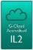







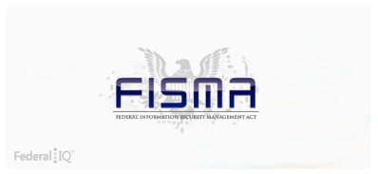

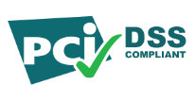

Extensive experience and credentials
CSA Cloud Controls Matrix
HIPAA/ HITECH
AU IRAP Accreditation
Singapore MCTS
SOC 1
SOC 2
UK G-Cloud OFFICIAL
CJIS
CDSA
2010
2011
2012
2013
2014
2015
ISO/IEC 27001:2005
FISMA
ATO
FedRAMP P-ATO
EU Data Protection Directive
PCI DSS Level 1
ISO/IEC 27018
Operations Security Assurance
Notes:
Slide title: Trustworthy foundation: Built on Microsoft experience and innovation
Slide objectives: Demonstrate Microsoft experience and innovation in cloud services.
Slide script:
Microsoft has decades of unmatched experience building enterprise software and running some of the largest online services around the globe beginning with the opening of its first data center in 1989.
Today, the Microsoft cloud infrastructure supports over 1 billion customers and 200 million businesses running in 76 markets worldwide.

Slide 57
Restricted Access & Use
AZURE:
Does not build back doors or weaken security protocols
Enables customers to encrypt data and mange the keys
Provides complete over data location and access
Will not disclose Customer Data to a third party (including law enforcement, other government entity or civil litigant) except as you direct or required by law
Will attempt to redirect third party request to the customer
Will promptly notify the customer, unless legally prohibited from doing so
Publishes a Law Enforcement Request Report that provides insight into the scope of requests
No Back Doors
Customer Control
Microsoft
Commitments
Encryption
Notes:
Slide title: Restricted use
Slide objective: Explain how Azure does not share data with its advertiser-supported services and does not mine customer data for advertising.
Slide script:
No Back Doors
Transparency through Government Security Program
We don’t weaken protocols
We don’t weaken security protections
Encryption
Encryption between customers and Azure, and between Azure datacenters by the end of 2014
Multiple encryption options
Customer control encryption keys
Customer Control
Data location
Access and use
On-premises, hybrid, and cloud
Data Privacy Commitment to Customers
Law Enforcement requests – Azure will not disclose Customer Data to a third party (including law enforcement, other government entity or civil litigant) except as you direct or required by law. First, we will attempt to redirect third party request to the customer. If required, we will promptly notify the customer, unless legally prohibited from doing so. Where a gag order attempts to prohibit us from doing this, we will challenge it in court. We’ve done this successfully in the past, and we will continue to do so in the future to preserve our ability to alert customers when governments seek to obtain their data.
Limits on data outside US - And we’ll assert available jurisdictional objections to legal demands when governments seek this type of customer content that is stored in another country.
Transparency - We will open a network of transparency centers that will provide these customers with even greater ability to assure themselves of the integrity of Microsoft’s products. Publish Law Enforcement Request Report.
Link to Brad Smith blog post (Dec 4): http://blogs.technet.com/b/microsoft_blog/archive/2013/12/04/protecting-customer-data-from-government-snooping.aspx
Excerpt:
Expanding Encryption
For many years, we’ve used encryption in our products and services to protect our customers from online criminals and hackers. While we have no direct evidence that customer data has been breached by unauthorized government access, we don't want to take any chances and are addressing this issue head on. Therefore, we will pursue a comprehensive engineering effort to strengthen the encryption of customer data across our networks and services.
This effort will include our major communications, productivity and developer services such as Outlook.com, Office 365, SkyDrive and Windows Azure, and will provide protection across the full lifecycle of customer-created content. More specifically:
· Customer content moving between our customers and Microsoft will be encrypted by default. · All of our key platform, productivity and communications services will encrypt customer content as it moves between our data centers. · We will use best-in-class industry cryptography to protect these channels, including Perfect Forward Secrecy and 2048-bit key lengths. · All of this will be in place by the end of 2014, and much of it is effective immediately. · We also will encrypt customer content that we store. In some cases, such as third-party services developed to run on Windows Azure, we’ll leave the choice to developers, but will offer the tools to allow them to easily protect data. · We’re working with other companies across the industry to ensure that data traveling between services – from one email provider to another, for instance – is protected.
Although this is a significant engineering effort given the large number of services we offer and the hundreds of millions of customers we serve, we’re committed to moving quickly. In fact, many of our services already benefit from strong encryption in all or part of the lifecycle. For example, Office 365 and Outlook.com customer content is already encrypted when traveling between customers and Microsoft, and most Office 365 workloads as well as Windows Azure storage are now encrypted in transit between our data centers. In other areas we’re accelerating plans to provide encryption.

Slide 58

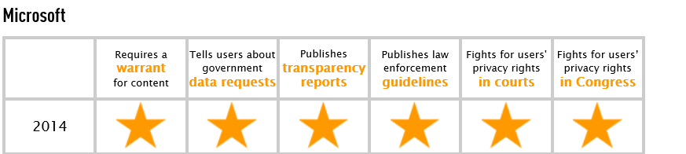
Restricted Access & Use
https://www.eff.org/who-has-your-back-government-data-requests-2014

